Slide 1
Elasticsearch Integration
GROUP MEMBERS
NIRAJAN KARKI (246108)
MD OHIDUL ISLAM (250822)

Slide 2
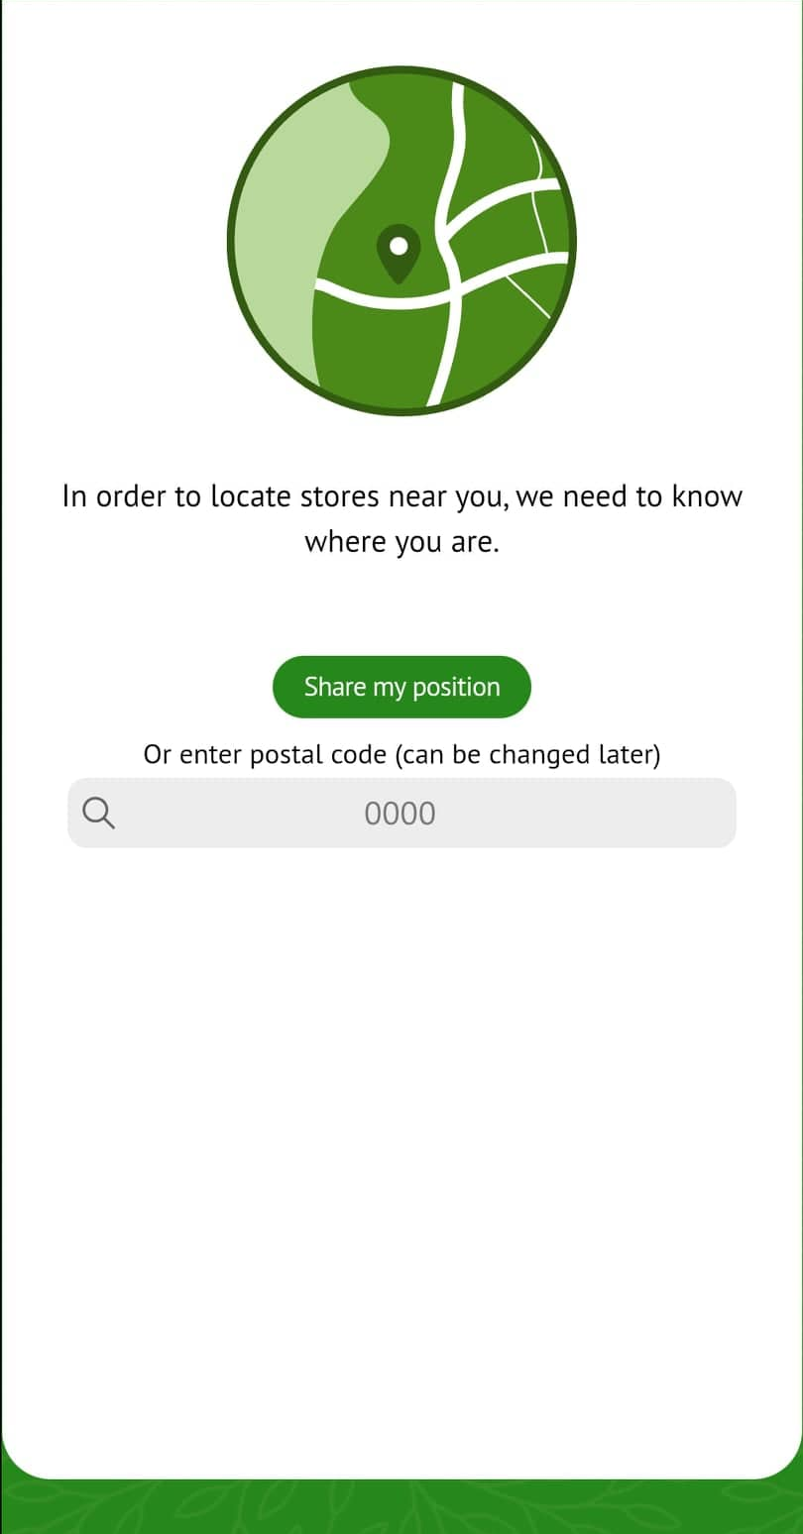
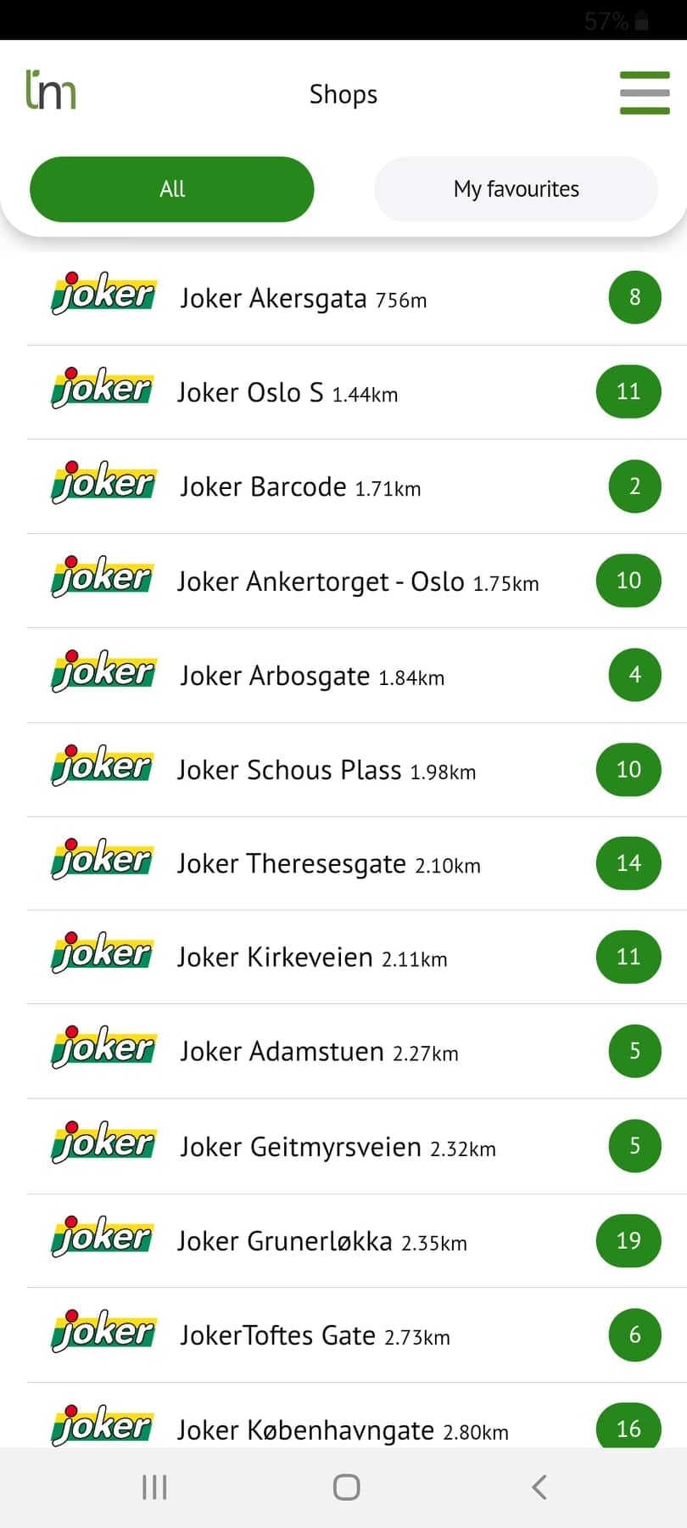
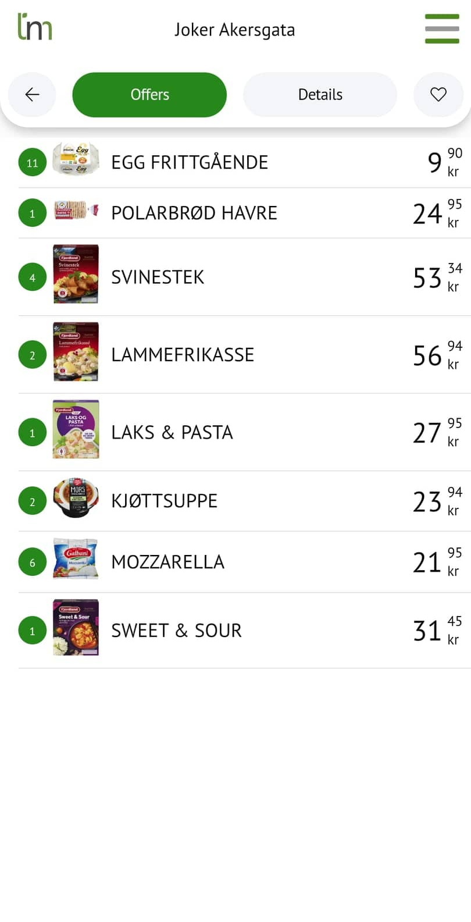
PROJECT BACKGROUND
1
2
3
Organization’s objective- reduce food wastages on shops
Existing ‘ThrowNo More’ application
Input – user’s location
Output – overview of goods at discounted price on various shops nearby

Slide 3
PROBLEM STATEMENT & PROJECT OBJECTIVE
PROBLEM
Users unable to peform such over products and offers
OBJECTIVE
Addition of search funtion to the existing solution
Able to search directly by the product
Have a better search experience

Slide 4
SOLUTION
Development of a full-text search engine
Use of Elasticsearch/ ELK stack
Why ELASTICSEARCH?
Document based
Distributed, but high availability
Open-source
Easy to use REST API
Horizontally scalable
High-fault tolerant

Slide 5
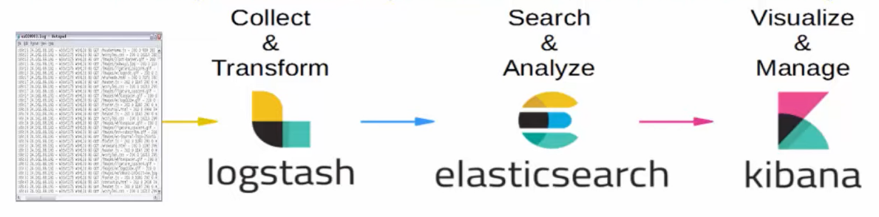
ELK STACK COMPONENTS
Elasticsearch ELK stack composed of three open-source projects:
E – Elasticsearch, is a search and analytics engine
L – Logstash, is a server-side data processing pipeline for ingesting data from multiple sources into the elasticsearch
K- Kibana, is a browser-based tool for visualization of data
Source: ProgrammingKnowledge

Slide 6
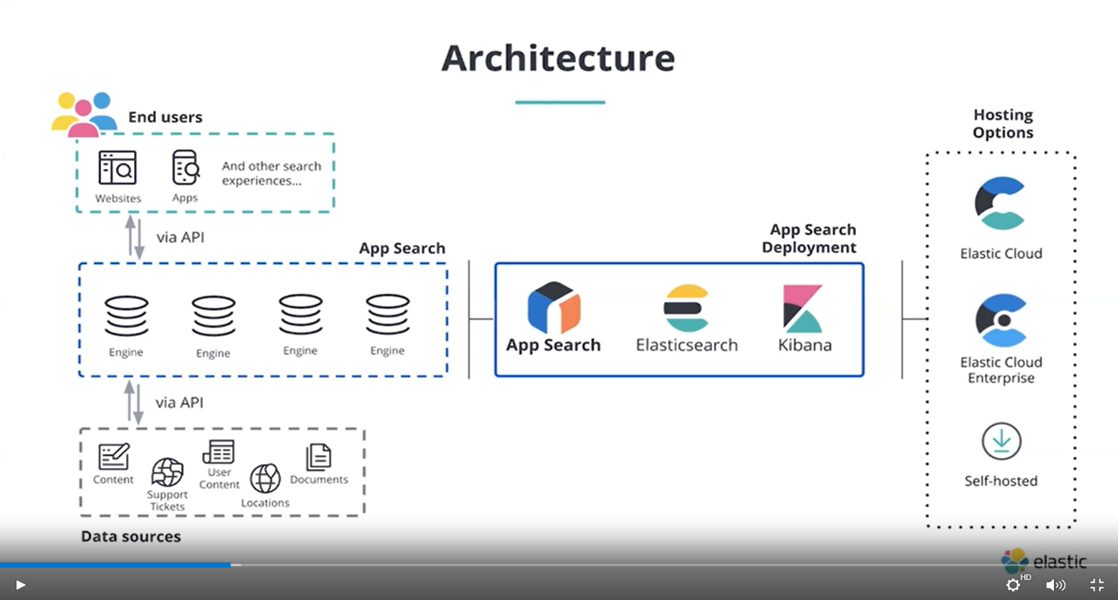
ARCHITCTURE OF SEARCH ENGINE
Source: elastic.co

Slide 7
Elasticsearch Basic Workflow
START
User enters search query/text
Users saves or upload files
Documents
JSON Documents
Query Parsing
Conversion to JSON
Searching
Tokenising of data to words
Indexing
Text Found?
Indexed Documents
Mapping
Display file path,total hits, time taken
Display “Text not found”

Slide 8
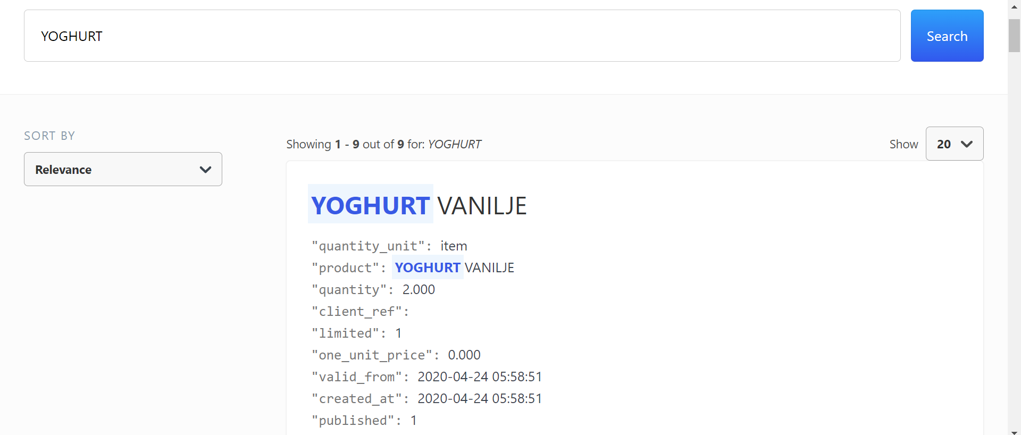
RESULT 1, OF THE QUERY

Slide 9
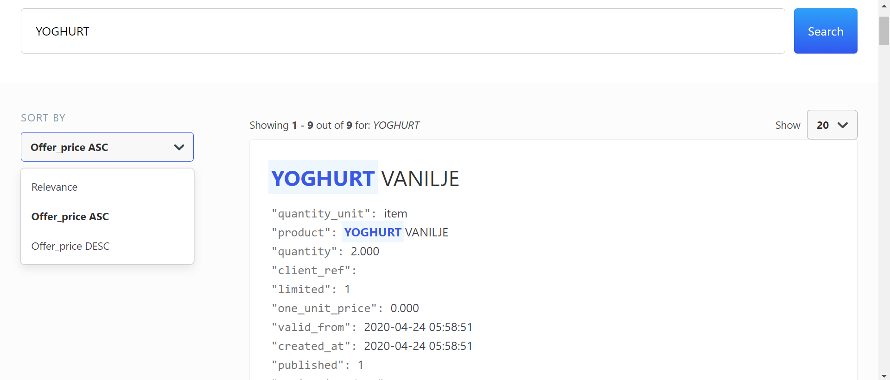
RESULT 2, OF THE QUERY/ SORT BY

Slide 10
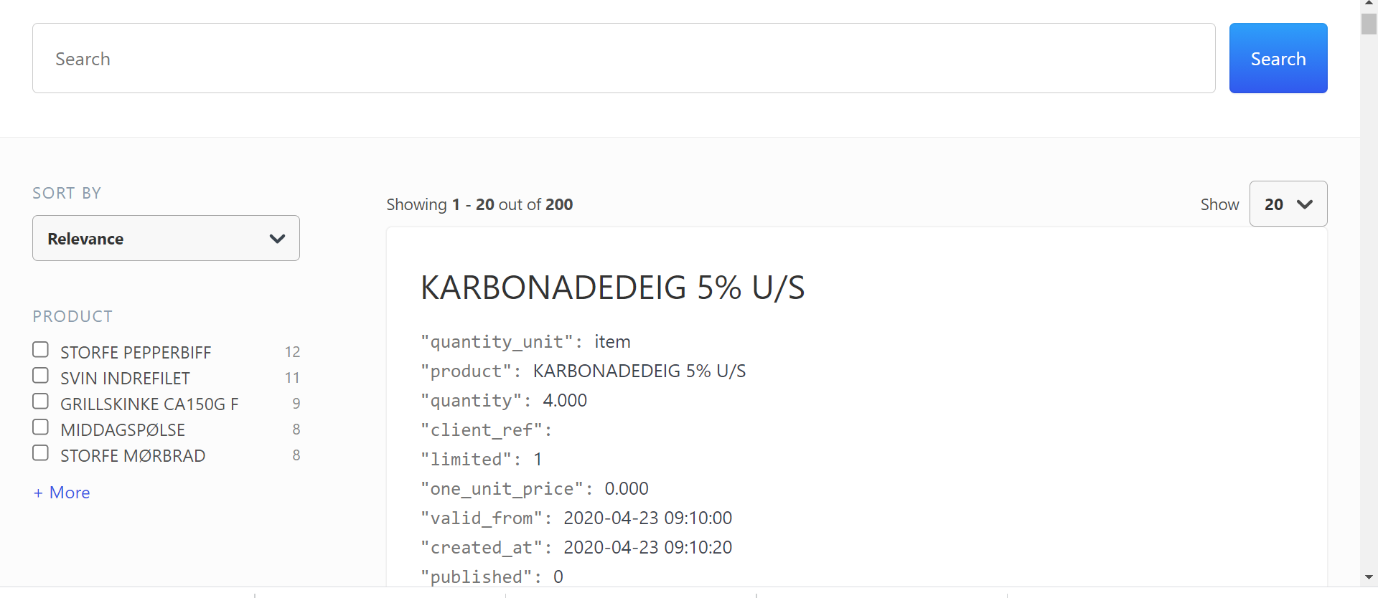
RESULT 3 OF THE QUERY/FILTER

Slide 11
DISCUSSION & CONCLUSION
Results verified and met expectations of the project
Able to develop a search engine
Enable users to search by product

Slide 12
FUTURE WORK
Self-hosting
Integration to the existing application

Slide 13
REFERENCES
Chow, N., & Tetrault, D. (2020). Webinar on getting started with app search. Retrieved from: https://www.elastic.co/webinars/getting-started-with-elastic-app-search
Divya, M., & Goyal, S. (2013). An advanced and quick search technique to handle voluminous data.
Han, L., & Zhu, L. (2020). Design and Implementation of Elasticsearch for Media Data. Paper presented at the 2020 International Conference on Computer Engineering and Application (ICCEA).
https://logz.io/learn/complete-guide-elk-stack/#elasticsearch
ProgrammingKnowledge. (2019). How to Install ElasticSearch Logstash and Kibana on Windows 10 (ELK Stack) (Elastic Stack). Retrieved from: https://www.youtube.com/watch?v=8iXZTS7f_hY&t=1s

Slide 14
QUESTIONS ?
THANK YOU !

